Slide 1
Research Question
Presentation by:
student id : 23092967
22099498
23105965
23069057

Slide 2
Dataset Id: 242
This dataset is important for us because it provides a rich source of data which can be analyzed in order to uncover patterns, trends, behavior and other market dynamics.
Notes:
The data set provides a rich source of data that can be analyzed to uncover trends, patterns, and insights into consumer behavior, market dynamics, and industry trends.

Slide 3
Dependent and independent variables:
In our dataset, the independent variables are many, such as buyer’s gender, age, discount and new car (true or false).
In our dataset, the dependent variable is only Sale Price.
Notes:
Independent variables is the variable that is manipulated or categorized to see its impact on other variables. In our dataset, the independent variables are many, such as buyer’s gender, age, discount and new car (true or false).
Dependent variables is is the outcome or response variable that is measured to see the impact of the independent variable.. In our dataset, the dependent variable is only Sale Price.

Slide 4
—Research Question
How does the age of buyers (Independent variable) and Discounts (Independent Variable) Influnce the sale price (dependent variable) of a car in the dataset?
Notes:
Now I would say that these variables help establish a causal relationship where the independent variables (Buyer Age, Discount) could explain variations in the dependent variable (Sale Price). The research questions based on the database are as follows: How does the age of buyers (Independent variable) and Discounts (Independent Variable) Influnce the sale price (dependent variable) of a car in the dataset?

Slide 5
Hypothesis
1. Null hypothesis (Ho):
Discounts and the Buyer’s age does not significantly impact Sale Price of Cars.
Notes:
The following null hypothesis assumes that there has been no relationship, difference or effect between the dependent and independent variable. It serves as the default position in order to test against whilst intending to reject it. in this dataset, discounts and buyer age do not significantly influence the Sale Price of cars. This reflects that any observed variation in Sale Price is due to random chance or other factors not considered in the study.

Slide 6
Hypothesis
2. Alternative Hypothesis (H₁)
Buyer Age and Discount significantly impact the Sale Price of cars.
Notes:
This hypothesis is the opposite to the null hypothesis which assumes the difference, effect and relationship between dependent and independent variable. If the null hypothesis is rejected and this one is then supported. In this case, Buyer Age and Discount significantly influence the Sale Price of cars which reflects the changes in sale price is related to the changes in discount and buyer age.

Slide 7

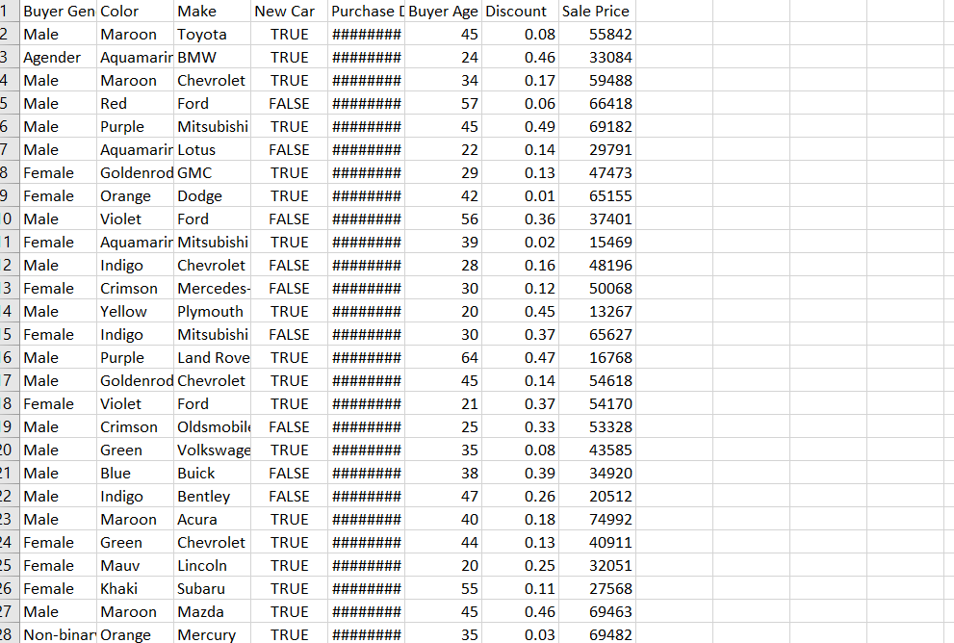
Dataset Overview
HOME

Slide 8

1. Null hypothesis (Ho):
Discounts and the Buyer’s age does not significantly impact Sale Price of Cars.
Notes:
The following null hypothesis assumes that there has been no relationship, difference or effect between the dependent and independent variable. It serves as the default position in order to test against whilst intending to reject it. in this dataset, discounts and buyer age do not significantly influence the Sale Price of cars. This reflects that any observed variation in Sale Price is due to random chance or other factors not considered in the study.

